Slide 1
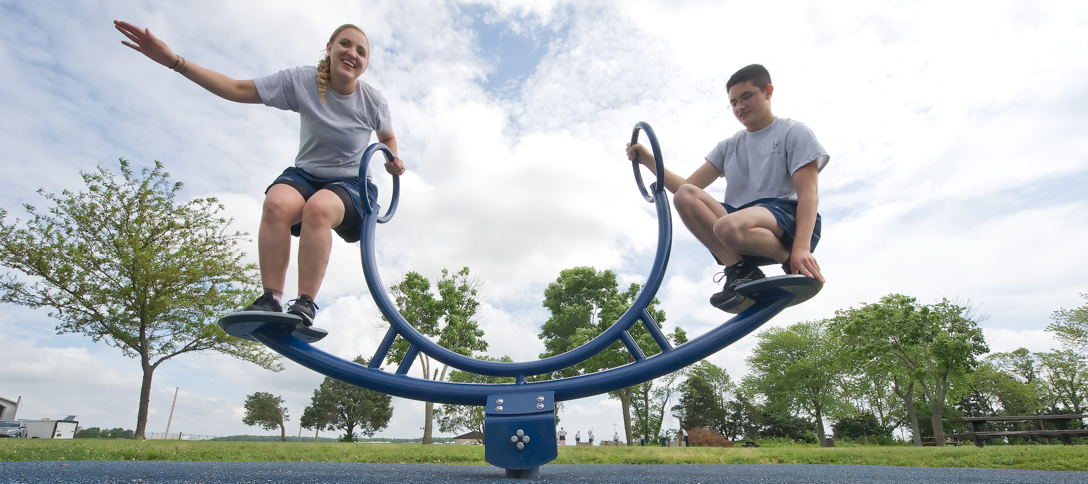
Simple Forces Revision
We will revise the forces we have learned about in class

Slide 2
We will revise forces
TRACK WITH ME
READ WITH ME
We will know what is on our mini-quiz
We will be able to remember our previous success criteria
We will be able to achieve our previous success criteria
DECLARE THE OBJECTIVE
Read the learning objective to your partner.
Notes:
Learning Objectives contain concepts (nouns, big ideas), skills (verbs, measurable behaviours) and sometimes context (restricting or targeting conditions).
●Example: Students will be able to describe the concept of density and apply it to floating and sinking.
●
Success criteria are specific measurable outcomes that if met mean that the student has met the learning objective.
Examples:
•Students will be able to compare densities of substances using mass and volume.
•Students will be able to identify whether a solid or liquid will float or sink in a liquid based on their densities.

Slide 3
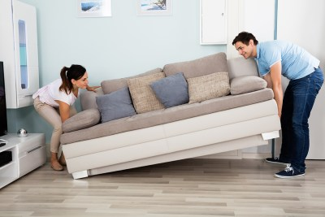
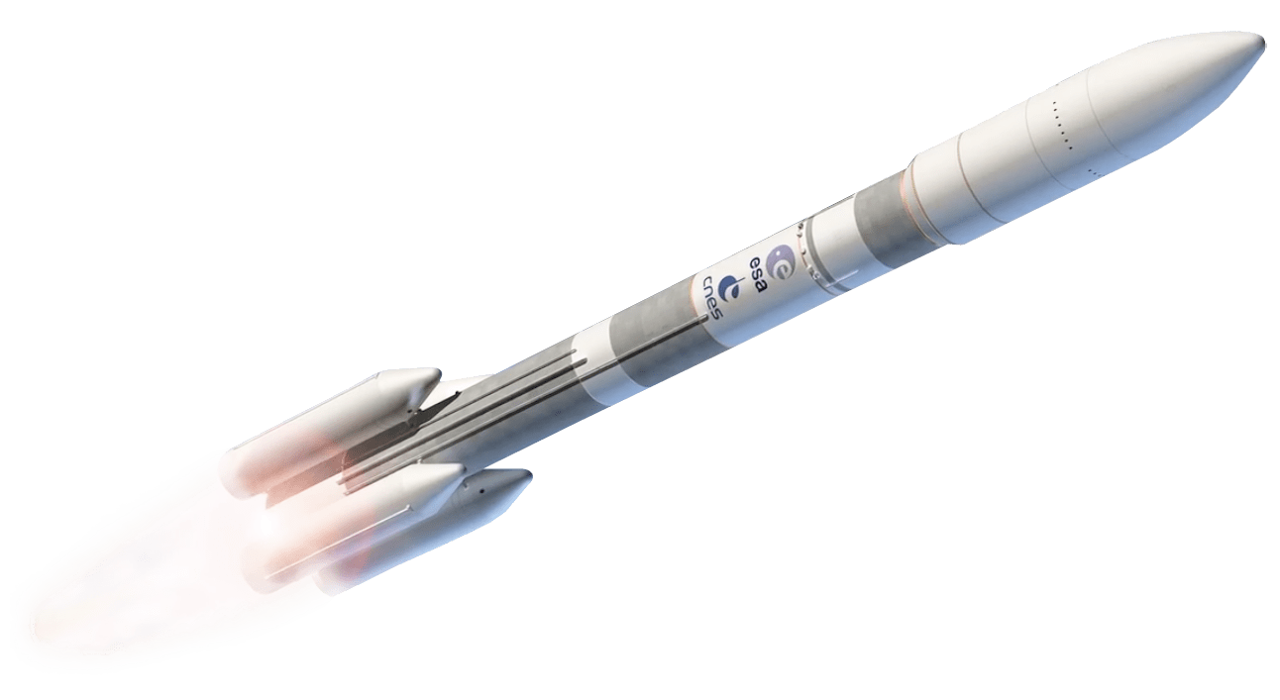

We will calculate net force using force diagrams.
CHECK FOR UNDERSTANDING
How do you calculate the net force? What would the net force of the rocket be (including units and direction)? Pair-Share Whiteboards
When force diagrams show the force as a number, we can calculate the net force.
The net force is the sum of all forces acting upon an object.
Net force = 35N Left
10N
5N
1000N
40N
5N
200N

Slide 4
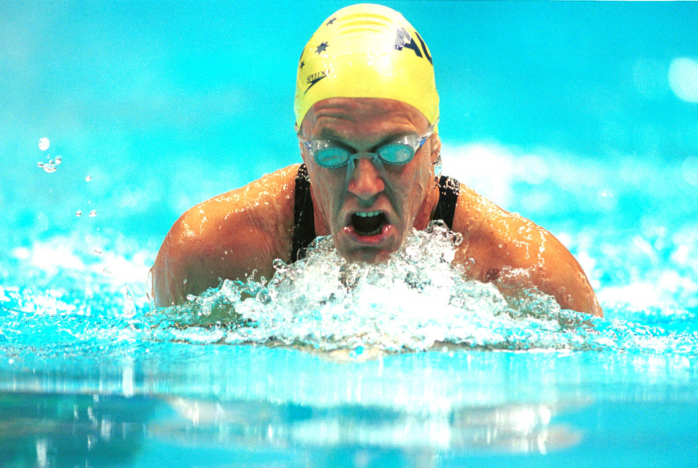
We will explain friction using familiar objects
Friction is the force that resists₁ movement between two objects that are touching.
We sometimes increase friction when we want something to stop or slow down. Such as catching a ball or opening a jar.
We can also reduce friction when we want something to stay moving or speed up. Such as a swimming race.
CHECK FOR UNDERSTANDING
Can you think of an example from Phys. Ed. where you might need to increase or reduce friction?
DEFINITION
1 - stops or slows 2 - impacts

Slide 5
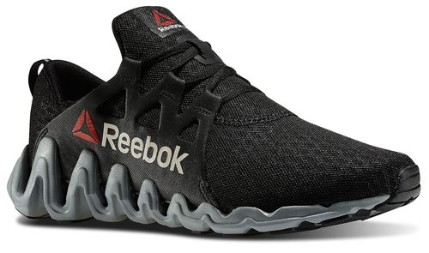
We will explain friction using familiar objects
CHECK FOR UNDERSTANDING
You are playing basketball and notice you are sliding all over the place on the court. Your shoes are worn out and you need new ones. Below is a force diagram of you slipping on the court. Draw a force diagram if your shoes were working properly.
Friction is the force that resists₁ movement between two objects that are touching.
It is a contact-force and affects₂ every object which touches another object.
The stronger the force of friction, the higher its coefficient of friction is.
Pushing force
DEFINITION
1 - stops or slows
Friction

Slide 6
We will explain inertia
CHECK FOR UNDERSTANDING
You are playing basketball and want to stop someone from landing a basket. What is something you can do to stop it from getting in?
Inertia is an object’s ability to resist a change in its speed.
To make the block below move, you need to provide a pushing force. Once you’ve pushed that block, due to its inertia, you then need to provide a force in the opposite direction to make it stop
DEFINITION
1 - stops or slows
Pushing force

Slide 7
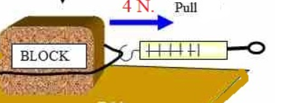
We will measure forces using newtons.
A Newton meter can also measure a force when an object is pulled on a surface. Newtons can be shown by a number followed by the letter N
This block is 4N of force to pull.
CHECK FOR UNDERSTANDING
How many newtons is the force of pulling this block? Is this force diagram showing a push, pull or twist?
Newton meter reads 4N

Slide 8


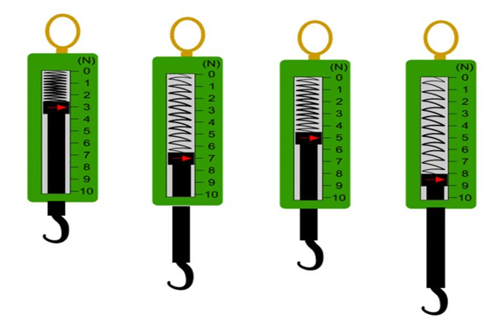
1 minute
We will measure forces using newtons.
Read the pointer in the newton meters below and calculate the newtons (N) for A-D
A B C D
Spring Balance | Force (N)
A
B
C
D
Teacher Cue
Complete A together

Slide 9
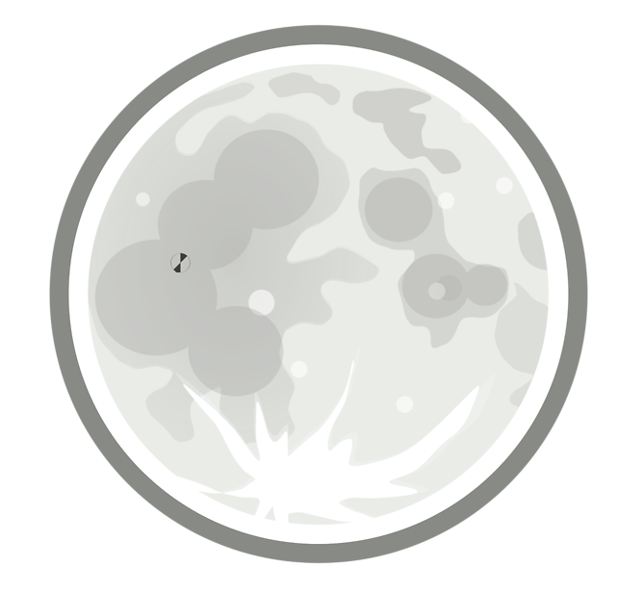
We will explain how gravity affects objects on Earth
Gravity is a force that pulls objects towards the centre₁ of the Earth.
Weight is a measure of the gravitational pull on an object. Being a force, we use newtons to measure weight.
Mass is a measure of the amount of matter₂. We use kilograms to measure mass.
We can convert between the weight (w) of an object and the mass (m) of an object using the equation w=10m, where the weight is in Newtons (N) and the mass is in kilograms (kg)
CHECK FOR UNDERSTANDING
Would your mass be different on the Moon? Justify your answer.
DEFINITION
1 - middle 2 - physical substance

Slide 10

We will discuss how objects float on water
CHECK FOR UNDERSTANDING
What is an example of a contact force acting on an object? Is the person in the picture below floating due to a contact or non-contact force?
Buoyancy is a force that allows objects to “float” on water.
An object can only float on water if it weighs less than the same amount of water
VOCABULARY
1 - touching

